Slide 1







Why we are using Web application nowadays?
What is a Web application ?

Slide 2








Slide 3











Server side scripts
Client side scripts

Slide 4
What is a web application ?

Slide 5
Server-side scripts
+
Client-side scripts
Storing and retrieving the data
Presenting the data

Slide 6
HTML
Hyper Text Markup Language, we have to use HTML tags for formatting the data (<element> </element> )
HTML is used to create web pages (either static or dynamic)
By default, a web browser will display exactly what you type. But we can format text by using HTML tags
HTML is the heart of web pages and HTML5 is the latest version to be approved by the World Wide Web Consortium (W3C)

Slide 7
HTML
Version Information
Head
Body
DOCTYPE
title
Block level
meta
Inline
favicon
Semantic
style
script

Slide 8
Head
Able to give a title to our webpage
We can keep an icon as favicon
Allows us to use external css, internal css and manifest files
The HTML <script> element is used to embed executable code or data, this is typically used to embed or refer to JavaScript code.
Provides a way to use meta elements

Slide 9
Head
title
Representing the title for a web site
style
Internal Styles
link
Favicon, Manifest and External styles
meta
The information represented in meta will reflects to entire document.
script
JavaScript functionalities

Slide 10
Body
The <body> tag in HTML is used to define the main content present inside an HTML page. It is always enclosed within <html>tags. The <body> tag is the last child of <html> tag. A body tag contains starting as well as an ending tag ( <body> </body> ).
Body
Block-level elements
All the semantic elements are the block-level elements
Inline elements
Semantic elements

Slide 11


Raster Images
Vector Images

Slide 12
Raster Images | Vector images
They are composed of pixels | They are composed of paths
Raster images occupies more space which depends on the quality | Vector images occupies less space
Cost of Raster images is low | Vector graphics cost more as compared to Raster images
The quality of image decreases when we zoom in it. | The quality remains same when we zoom in it.
Load time is very low than Vector images | Load time is fast as they occupies less storage range.
Ex: GIF, BMP, JPG,TIF, etc.., | Ex: SVG,EPS,PDF,AI,etc..,

Slide 13
Meta
name
Document-level metadata, applying to the whole page.
http-equip
providing information equivalent to what can be given by a similarly-named HTTP header
charset
Giving the character encoding in which the document is encoded.
itemprop
The meta element provides user-defined metadata.

Slide 14
Block Level Elements
Block-Level Element
Block-Level Element

Slide 15
Block-Level Elements
Heading tags
Header
h1
Main
Paragraph
h2
Footer
h3
List
Section
h4
Division
Article
h5
Table
Aside
Ordered
Unordered
Description
h6
Hr
Semantic Tags
Etc..,

Slide 16
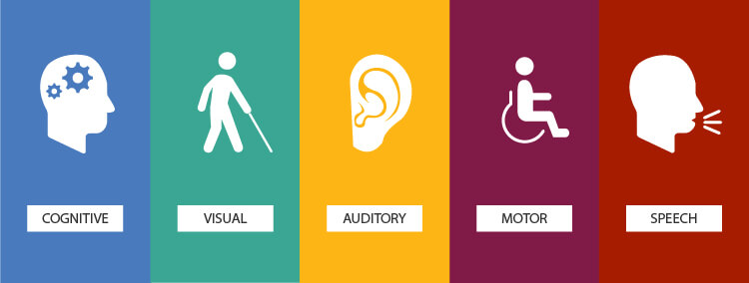
The power of the Web is in its universality.
Access by everyone regardless of disability is an essential aspect.
Tim Berners-Lee

Slide 17
Header
Navbar
Sidebar | Article
 | Section
Footer
<div id=”header”>
<div id=”nav”>
<div id=”article”>
<div id=”sidebar”>
<div id=”section”>
<div id=”footer”>

Slide 18
Inline Elements
Inline Element - 1
Inline Element - 2
Inline Element - 3
Inline Element - 4
Unlike block level elements, Inline elements do not force a new line to begin in the document flow

Slide 19
Inline Elements
Anchor
Span
Image
Code
Button
Form-controls
Font styling elements

Slide 20
Navigation in HTML

Slide 21
Navigation in HTML
Inbound
Outbound
Mailto
Tel

Slide 22
Form controls in HTML

Slide 23
Advanced Form controls in HTML

Slide 24




Form in HTML
action
Specify where the formdata is to be sent to the server after submission
method
Specifies how to send form-data
Specifies a name or a keyword that indicates where to display the response
target
enctype
Specify how the browser encodes the data before it sends it to the server

Slide 25
Form controls in HTML
Input
Radio button
Checkbox
File
Select
Hidden
Submit and Reset

Slide 26
Form controls in HTML
Textarea
Files

Slide 27
iFrame in HTML
<iframe> </iframe> allows us to load external web pages in the existing web document.
iframe works with the following attributes.
src
name
width
height
frameborder
scrolling

Slide 28
VIDEO
AUDIO

Slide 29
Multimedia elements in HTML

Slide 30
HTML
Doctype
Head
Body
Navigation
Span
Img
Button
Form-controls
Font-styling
HTML
Title
Inline elements
Style
Block-level elements
Name
Http-equip
Charset
itemprop
Meta
Header
Main
Nav
Section
Article
Aside
Footer
Heading
Div
Lists
Paragraph
Table
Semantic
Favicon
Stylesheet
Link
Unordered
Ordered
Description
Script

